Slide 1
Descriptive Analysis and Rhetorical Criticism
NCLC 203, Spring 2010
Janette Kenner Muir, Ph. D.
Associate Professor of Integrative Studies
New Century College George Mason University
jmuir@gmu.edu

Slide 2
Descriptive Analysis in Action Research
Different ways to extend understanding of the situation and the issues being investigated.
Qualitative research that provides an additional descriptive account of a community, an organization or group.
Note to remember: “Descriptive analysis” is a phrase also used later in studies as researchers work with the data they have gathered.

Slide 3
Ways descriptive analysis works in action research (Stringer, pgs. 83-86)
Ethnographically collect information (elicit multiple responses from groups – focus groups and interviewing)
Pose six questions – who, what, when, where, why, how (interviews, survey kinds of questions)
Create community profiles – stakeholders describe significant features of their context, providing a “snapshot” for the investigation.

Slide 4
Rhetorical Criticism
Consider the full range of information about a community or group
Types of rhetorical artifacts that might be considered include:
Public documents
Minutes from community meetings
Literature from nonprofit organizations
Speeches and debates by community leaders
Icons, photographs and other images

Slide 5
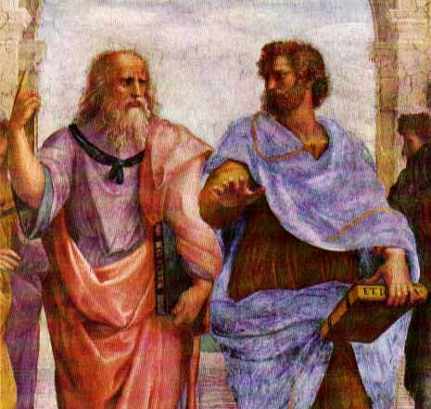
The Study of Rhetoric
The study of all the available means of persuasion in any given situation.
How arguments or claims are invented, organized and presented.
Three types of proof – ethos (credibility), logos (logic) and pathos (emotions)
Aristotle, The Rhetorica

Slide 6
Rhetorical Analysis as Action Research
How language is used to persuade others – metaphors, analogies, symbols;
How narratives or stories are being told;
How people come to identify with one another through common bonds;
How organizations shape their image through public messages;
How systemic problems continue because of recurring persuasive (rhetorical) messages.

Slide 7
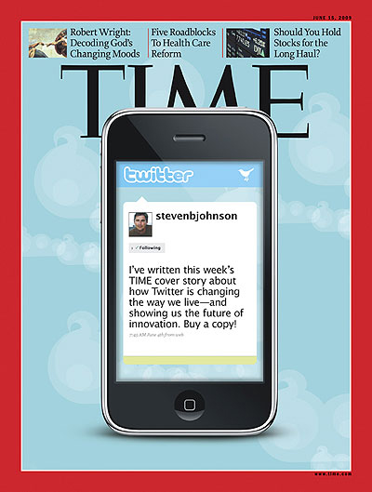
How Rhetoric Brings Change
Kuypers, “Rhetorical Criticism as Art”
“Essentially, through analysis and evaluation of rhetorical acts (artifacts) we begin to understand how humans use rhetoric to bring about change in the world
around them” p. 13.

Slide 8
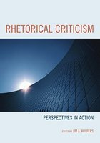
Rhetorical Criticism
Stage 1: Conceptual
Insight about rhetorical artifact –
no standard way to think about this.
Instinctive reactions; trained observations
Systematic examination
Starts with a research question then examines artifacts to answer that question
Employs a more formal guide or rhetorical perspective to answer the question

Slide 9
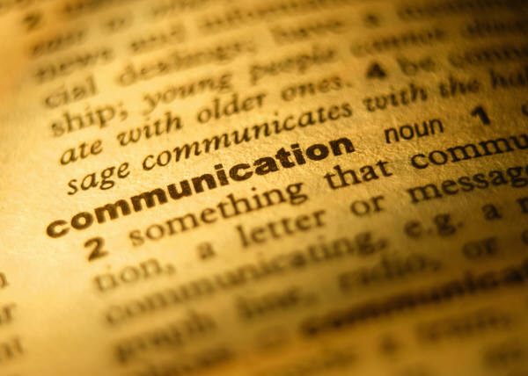
Stage 2: Communication
The process of writing – considers audience, purpose, intended result
Examples: a letter to the editor, a proposal for funding, a report to a community agency
Making propositions with good supporting arguments – stating case, providing evidence
Argue for a certain understanding of the rhetoric, often based on a theoretical perspective.

Slide 10
Stage 3: Counter-Communication
Sharing views openly – exchange and discussion of ideas is crucial to criticism.
Sharing criticism with the hope that
feedback will be provided
“Entering into dialogue about matters of importance” Kuypers, p. 19.

Slide 11
The Three Components of Rhetorical Criticism
Description
What is being examined?
How is it being examined?
Why is it relevant?
Analysis
What is in a rhetorical artifact and what does it mean?
How does the artifact work?
Evaluation
Judgment about the artifact – fair-minded description, standards of judgment based on perspective taken
Critique becomes a rhetorical artifact as well.

Slide 12
Applying Rhetorical Criticism
As a group, look at the rhetorical artifact that you’ve been
given related to your Literacy RING.
Describe the artifact – what is it, why is it relevant?
Analyze what you think the artifact is trying to convey? How does it work?
Make a judgment about the effectiveness of the rhetorical artifact.
Be prepared to share findings with class (if time allows).

Slide 13
New Media RING

Slide 14
Education RING

Slide 15
Family RING

Slide 16
Homelessness RING

